Slide 1



Stress
Awareness
© MIMHC 2021

Slide 2



Factors that can cause
Stress
Workplace stresses - unachievable deadlines, heavy workload, unrealistic targets, unsafe working environments, lack of leadership and communication, bullying, negative workplace culture, discrimination based on sex, race, ability, age or sexual orientation.
External stresses - relationship breakdowns, financial worries, bereavement, traumatic events, physical health conditions, isolation from family and friends, discrimination such as racism or homophobia in the local community.
Individual needs - it is important to remember not everyone experiences things the same way and they process them differently. What some people may find motivating others will find stressful and will worry.
© MIMHC 2021

Slide 3
Signs of Stress
Tiredness
Irritability
Social Withdrawal
Weight loss or gain
Struggling to cope with everyday tasks
Change in personal appearance
Change in usual demeanour or behaviour
Frequent or sporadic absences
© MIMHC 2026

Slide 4

Ways to cope with Stress
© MIMHC 2026

Slide 5
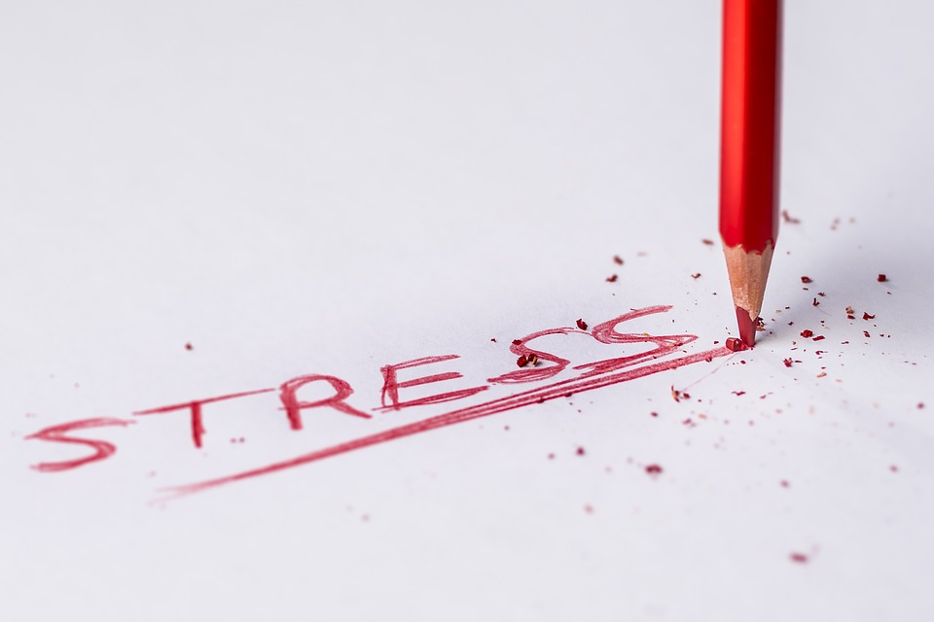
1. Reframe unhelpful thoughts
The way we think, feel and behave are linked. Sometimes we develop patterns of thoughts or behaviours that are unhelpful so recognising them, and taking steps to think about things differently, can improve your mental health and wellbeing.
Let it go - one technique to help with this is to write your negative thoughts down and then mentally leave them on the paper. Notice them and let them go.
© MIMHC 2026

Slide 6

2. Be in the present
If we take time to be aware of ourselves and be in the present moment, noticing our own thoughts and feelings, and the world around us, we can gain a better perspective. Sometimes this is known as being more mindful.
Check in with a body scan- Stop what you are doing and concentrate on your breathing for a minute. When you are focused start to mentally scan each part of your body from bottom to top and notice how you feel. It will help you be present in your body and in the moment.
© MIMHC 2026

Slide 7

3. Get good sleep
Good-quality sleep makes a big difference to how we feel mentally and physically, so it's important to get enough.
Keep your bedroom as a space for you to sleep by making it a screen free zone. The bright lights of screens can keep us alert so try to stay away from phones, TV etc once you go to bed. Reading a book or meditation can help relax you if you find it hard to go to sleep. If you normally sleep with the TV on and like a bit of noise, try switching to white noise as a substitute.
© MIMHC 2026

Slide 8

4. Connect with others
Spending quality time with friends or family, talking to someone about how we are feeling or finding ways to help other people can all help stop you from feeling lonely and improve your mental health and wellbeing. This can be online, by phone or seeing someone in person.
Remember we have in house mental health first aiders and all our line managers are now trained in mental health support if you need to talk.
© MIMHC 2026

Slide 9

5. Live a healthy life
Being active, enjoying the outdoors and having a healthy, balanced diet all impact how we feel. Also, binning bad habits like smoking, and cutting down on alcohol and caffeine can have a positive effect on our mood.
© MIMHC 2026

Slide 10

6. Do something for yourself
From enjoying your favourite hobby, learning something new or simply taking time to relax, it's important to do things that make you happy, like trying a new hobby or learning a new skill.
© MIMHC 2026

Slide 11

Get your personalised
‘Mind Plan’
Get Your Mind Plan - Every Mind Matters - NHS (www.nhs.uk)
Answer 5 questions to get top tips and advice that work for you.
© MIMHC 2026

Slide 12

www.mimhc.co.uk
© MIMHC 2026

